Slide 1
1, 2, 3… Yenza!
Accessing the GEC Trial’s Inclination Assessment on TeacherConnectchat
Assessing 21st-Century Skills and its Impact on classroom practice

Slide 2
Agenda
Icebreaker The alternative uses games.
Activity 1 Defining 21st-Century Skills.
Activity 2 Identifying 21st-Century Skills.
Activity 3 Reflecting on our experiences.
Activity 4 Embedding 21st-Century Skills in teaching and learning.

Slide 3
ICEBREAKER
Preparing to use our 21st-Century Skills

Slide 4
The “Alternative Uses” game
Pick one image from the images on your tables. (1 per person).
Spend 1-minute brainstorming as many unconventional (unusual) uses for your chosen object as you can. Please do this independently.
For example, if you picked a picture of a fork, you could think of it as:
A comb for your hair
A painting tool that creates three lines at once
A gardening helper for sowing small, evenly-spaced seeds
Unique, dangling earrings
A personal back scratcher
After the minute is up, everyone will share their creative ideas with the group. Consider the following:
The total number of different uses you thought of.
How unique your ideas are.
Notes:
The 'Creative Alternatives' game is designed to stimulate your creativity and stretch your ability to think outside the box. It encourages flexible thinking and problem-solving, key aspects of 21st-Century Skills. This exercise helps us practice divergent thinking, a type of thinking that generates many new ideas and fosters innovation, adaptability, helps us to solve problems, enables us to tolerate ambiguity. So, it's a perfect warm-up for our session about incorporating 21st-Century Skills in teaching and learning, because, divergent thinking prepares us to navigate complex and unpredictable situations, fostering their readiness for the challenges of the 21st century.

Slide 5
INTRODUCTION
Setting the scene

Slide 6
Introduction
Why are we here?

Slide 7
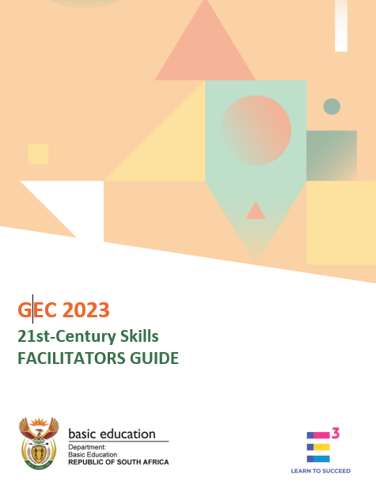
Goal
The goal of this workshop is to enable participants:
to define 21st-Century Skills
to use a simple 21st-Century observation rubric
So that participants can effectively and confidently train other teachers.
Notes:
Presenter notes [Please read all notes as part of your presentation]
The purpose of this online training is to….
CLICK – help you understand the overall goals of the GEC
CLICK- To know what the GEC Classroom methodologies are
CLICK – To know and understand the key design features of the GEC assessment model.
CLICK - To understand the plan and expectations around the GEC 2022 field trial.

Slide 8
Introduction
The outcome of this workshop is:
By the end of this workshop participants will be able to:
Clearly articulate the definition of specific 21st-Century Skills.
Accurately identify the presence of 21st-Century Skills.
Understand principles from the science of learning to integrate 21st-Century Skills into their teaching methodologies.
Understand how to grow the 21st-Century Skills through the Integrated Projects

Slide 9
The curious questions
We will explore how we
Define what 21st-Century Skills are.
Identify these 21st-Century Skills
Embed these 21st-Century Skills in teaching and learning – what the science of learning tells us.
We will answer the Curious Questions
Revisit - What are 21st-Century Skills and why do we need them?
How do we define 21st-Century Skills
How do we identify these 21st-Century Skills?
How can we embed these 21st-Century Skills into our teaching and learning? What are the conditions needed to successfully grow learners’ 21st-Century Skills?
Notes:
In this training, we will explore how we prepare learners with skills for a changing world by addressing the following topics:
Defining what 21st-Century Skills are.
Embedding these 21st-Century Skills in teaching and learning – what the science of learning tells us.
Identifying these 21st-Century Skills
The purpose of this online training is to….
CLICK – help you understand the overall goals of the GEC
CLICK- To know what the GEC Classroom methodologies are
CLICK – To know and understand the key design features of the GEC assessment model.
CLICK - To understand the plan and expectations around the GEC 2022 field trial.

Slide 10
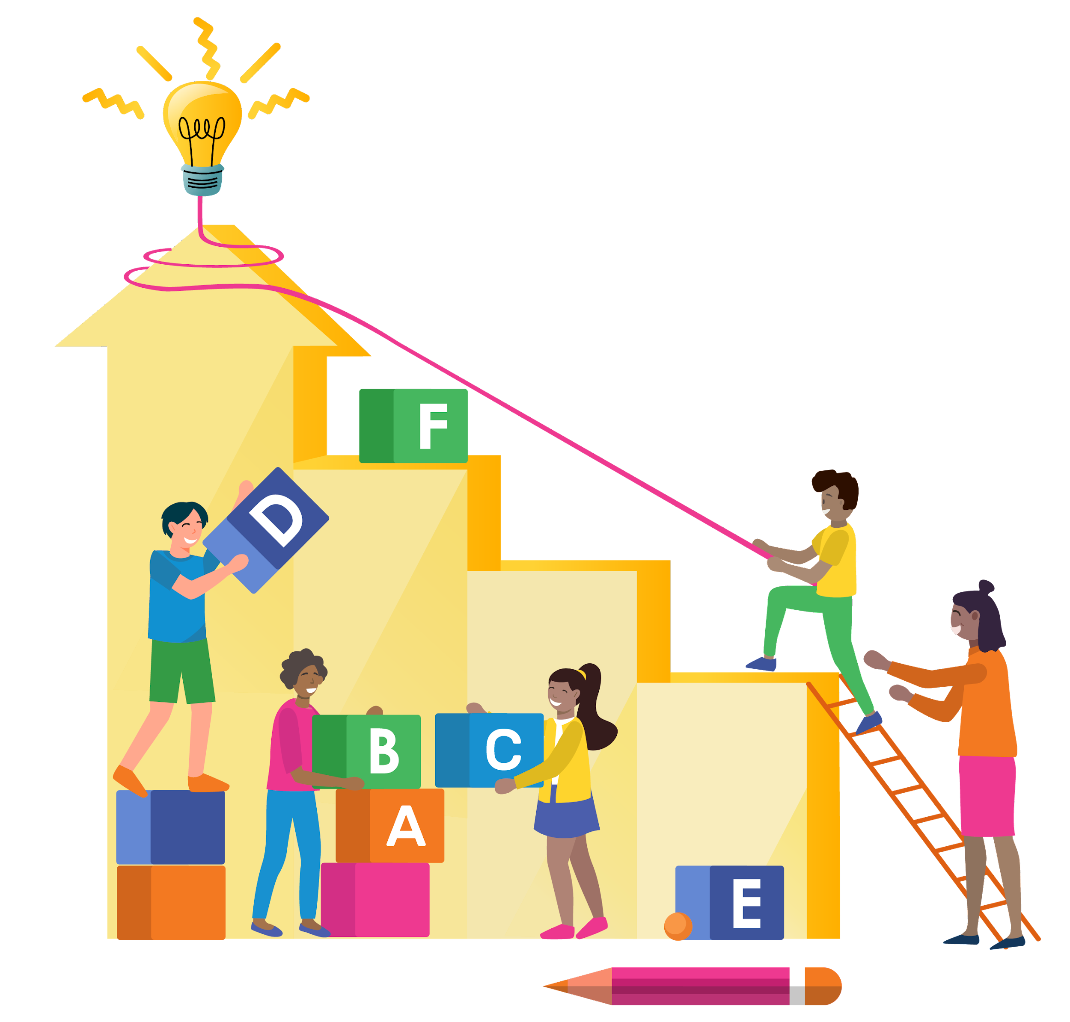
Your participation
Socially Interactive - with opportunities for participants to collaborate and work together
Purposeful - real life, authentic, and meaningful.
Enjoyable - with the right level of challenge, for deep learning to happen we need to go beyond our comfort zone.
Curious - using the curious questions to guide this workshop, we encourage you to ask your own curious questions.
Iterative - due to time constraints there will be limited opportunities to seek feedback, apply feedback, and to iterate.
Actively engaging - providing you with opportunities to think deeply about the content (i.e. this will not be a chalk-and-talk).
Learner agency - providing you with opportunities to make decisions about how you want to tackle the activities and tasks.
Notes:
Theses practices of SPECIAL come from the Science of learning and help us to create significant learning experience, experiences that will be memorable, durable and transferable. So think about how some of this learner could be relevant to you in other areas of your life.

Slide 11
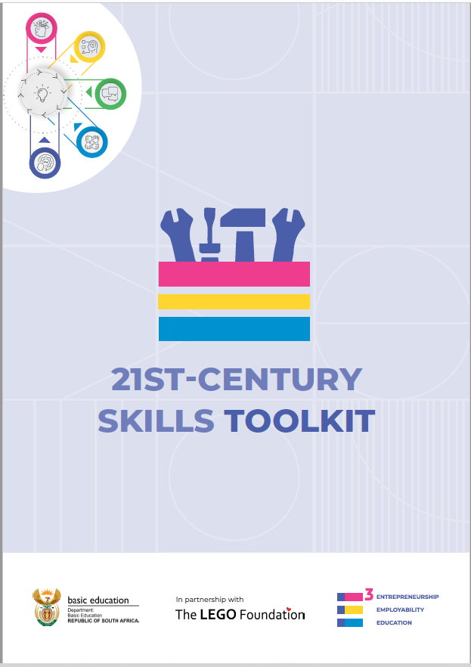
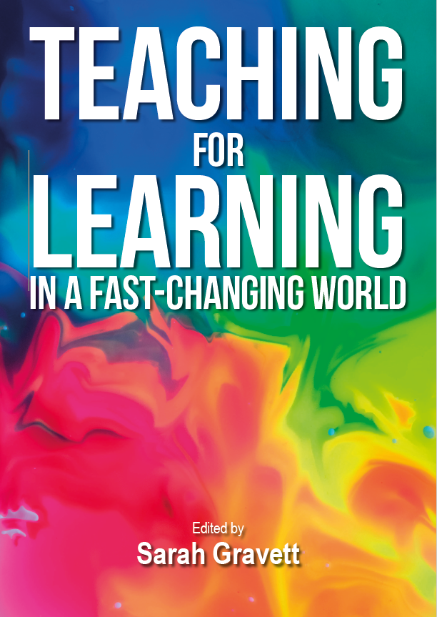
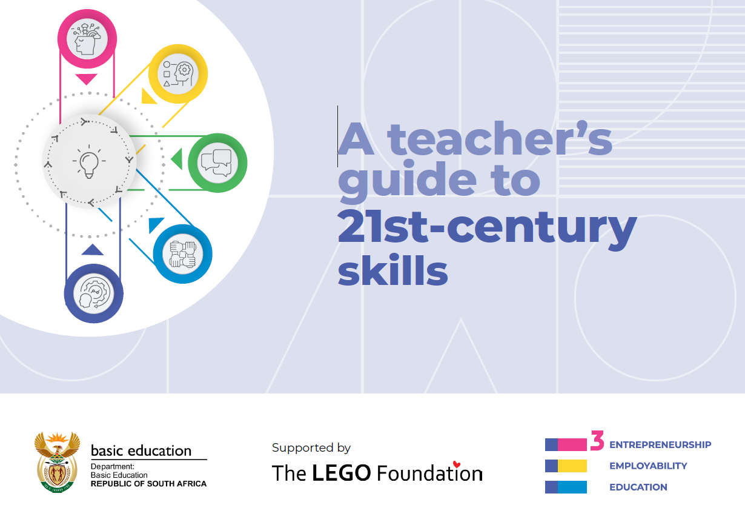
Further resources

Slide 12
ACTIVITY 1: DEFINING
21st-Century Skills

Slide 13
Let’s recap
What are 21st-Century Skills and why do we need them?

Slide 14
Ask the audience
Why do we need to define the 21st-Century Skills
Science of learning: Assessing prior knowledge

Slide 15
Why do we need to define skills?
Sometimes these skills can be confusing because they can seem intangible, so we are making the intangible tangible by:
Creating a common language to make discussing them easier
Facilitating the process of being able to identify them more easily
Creating an easy-to-use framework/rubric

Slide 16
Purpose of the 21st-Century Self Assessment
What: Complete the 21st-Century Self-Assessment Template.
Why: To allow you time to think deeply and engage with the content of the 21st-Century Rubric.
So that when we use the rubric in the next activity you are already familiar with it.
Science of learning: attention and engagement, deep thinking

Slide 17
21st-Century Self Assessment
1. Read each statement carefully: Take your time to understand what each statement is asking about.
2. Reflect: Reflect on how often you do what's described in the statement.
3. Choose your answer: For each statement, pick the option that best fits you (never, rarely, sometimes, often, always)
4. Be honest: There are no right or wrong answers.

Slide 18
Discuss in pairs
Did anything surprise you about your answers?
Which skills are you strongest at, can you give some practical examples to support your answers?
Which skills are you not as strong at, what do you think you could do to grow these skills?

Slide 19
Ask the audience
SHARE YOUR EXPERIENCES AND ASK ANY QUESTIONS

Slide 20
ACTIVITY 2: IDENTIFYING
21st-Century Skills in the classroom

Slide 21
Ask the audience
How do we identify these 21st-Century Skills?

Slide 22
Recap
The 'Observation Rubric' provides clear, specific definitions that guide the identification of key 21st-Century Skills, that helps you to observe and then record your observations
What is the observation rubric?
Notes:
"The 'Observation Rubric' is a user-friendly tool that clearly outlines five key 21st-Century Skills. It also offers specific descriptors that observers can look for during class activities. The primary aim of this rubric is to assist educators in easily spotting these skills so that they can be nurtured and grown during class over the course of the year.

Slide 23
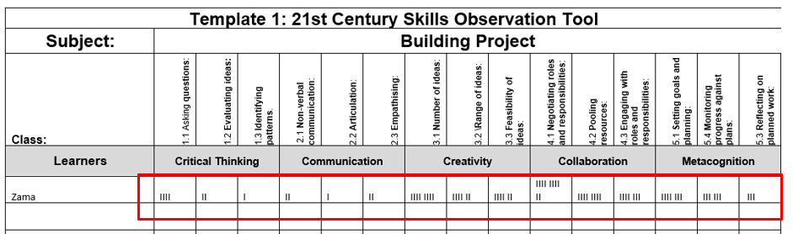
Template 1: how to use it
Write the name of the participants in the column on the left.
Observe the group activity.
Every time you see any of the sub-skills, make a mark on your observation template.

Slide 24
Round 1 Observing and Building
Group 1 does Task 1
Group 2 does Task 2
The cellphone tower project
Construct a cell phone tower at least 50cm high using only the given materials.
Discuss and assign roles and responsibilities within your team.
Make sure the tower can hold three board markers or similar items.
Observe 21st-Century Skills
Select a member(s) of the building team to observe.
Observe your building project team members.
Use the rubric to track when a 21st-century skill is shown.

Slide 25
Round 1 Observing and Building
Group 2 does Task 1
Group 1 does Task 2
The bridge building project
Construct a bridge at least 30cm long and 10cm high using only the given materials.
Discuss and assign roles and responsibilities within your team..
Make sure the bridge can hold three board markers or similar items.
Observe 21st-Century Skills
Select a member(s) of the building team to observe.
Observe your building project team members.
Use the rubric to track when a 21st-century skill is shown.

Slide 26
Ask the audience
ACTIVITY DEBRIEF, SHARE YOUR EXPERIENCE AND ASK ANY QUESTIONS

Slide 27
Template 2: Scoring rubric
1. Use your observations from the 21st Century Skill Observation Tool (Template 1) to help you to decide what score you will give each participant for each sub-skill.
2. Score each sub-skill based on how often it was observed.
3. Record these scores on the Subject Teacher Capturing Template (Template 2). Each skill's score is the total of its 3 sub-skills.
Remember, these scores are not for marks, promotion, or progression. They simply state the frequency in which these skills have been practiced and observed. These score does NOT imply any level of competence.
Give a score from 0-4 for each sub-skill.

Slide 28
The scoring rubric
0 Never: The behaviour was not seen
1 Rarely: The behaviour occurs but not often
2 Sometimes: The behaviour occurs about half the time
3 Often: The behaviour occurs most of the time
4 Always: The behaviour is consistent and regular

Slide 29
Template 3: Consolidation
Subject teachers give their filled 'Subject Teacher Capturing Tool' (Template 2) to the class teacher.
The class teacher combines all scores from different subjects into 'Class Teacher Consolidation Template' (Template 3).
If done on Excel, this template will automatically convert the scores to a scale of 10, which can then be entered into SA-SAMS.
Finally, Template 3 is given to the person in charge of entering scores into SA-SAMS.

Slide 30
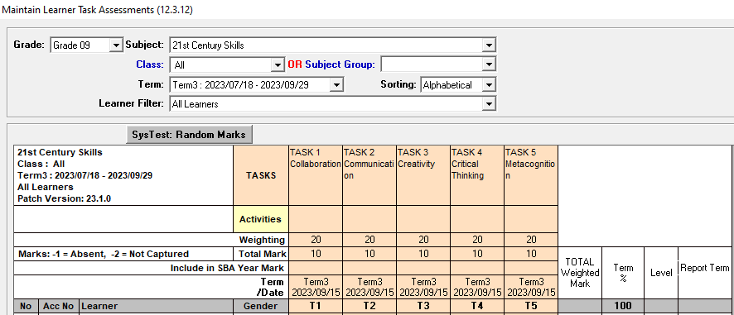
Upload marks to SA SAMS

Slide 31
Ask the audience
SHARE YOUR EXPERIENCES AND ASK ANY QUESTIONS

Slide 32
ACTIVITY 3: REFLECTING
What did we learn?

Slide 33
Activity 3: Why should we reflect
“We do not learn from experience … we learn from reflecting on experience”
John Dewey

Slide 34
Activity 3: Let’s reflect
Did you observe all skills in 20 minutes?
What did you find challenging?
What did you like about this?
What questions do you have?

Slide 35
ACTIVITY 4: EMBEDDING
Understanding the learning environment and conditions needed to grow and then measure the development of 21st-Century Skills.

Slide 36
Objective 2
How can we embed these 21st-Century Skills into our teaching and learning?
Understanding the conditions needed to successfully grow learners’ 21st-Century Skills.

Slide 37
Activity 4: 21st century teaching and learning
21st-century learners
require
21st-century teachers
using
21st-century approaches
(e.g. integrated projects)
Who are self-directed as they identify and solve problems and create value for everyone.

Slide 38
Activity 4: 21st century teaching, creating significant learning experiences
Teaching is ultimately about guiding and supporting meaningful learning, which leads to significant learning experiences for learners.
“Significant” is learning that is…
Meaningful - it is relevant and relatable to learners' lives.
Long lasting - it is not easily forgotten.
Transferable - learning that can be applied to different situations and contexts.
2013 - Dee Fink, Significant learning experiences
Notes:
Getting us all on the same page.

Slide 39
Activity 4: How do we create significant learning experiences? What does the science say?
Insights from the science of learning indicate that there are FOUR fundamental principles of learning that are common to how all humans learn.
Embedding these can lead to learners practicing and growing their 21st-Century Skills because they experienced what we call…
significant learning

Slide 40
A recipe for significant learning
THE HOW?
Insights from the science of learning tell us that learning happens best when we…
4
1
2
3
Provide opportunities for learners to think deeply (engagement) about a topic/activity/
task
Create a learning environment which is caring and safe.
Use different techniques to capture the learner’s attention
+
Access learners’ prior knowledge
+
+
Young people practicing and growing their 21st-Century Skills
=

Slide 41
The ingredients to embed 21st-Century Skills
THE WHAT?
What ingredients should we include when we design significant learning experiences…
S
How can I create opportunities for social interaction in my lessons?
Ensure Social Interaction
Make learning Purposeful
How is this activity or the project as a whole relevant and relatable to my learners?
P
Access Prior Knowledge
How am I finding out what learners already know and what their perceptions are?
E
How can I strike the right balance between challenge and manageability, so that learners have the opportunity to practice their resilience as they persist through challenges, getting to the joy as they eventually succeed?.
Create Enjoyment
C
How can I design activities that stimulate curiosity and engagement?
Instill Curiosity
I
How can I effectively create opportunities for learners to seek and apply feedback, iterate their ideas throughout the course of the project/task.
Opportunities for Iteration
A
How can I ensure that the activities I've designed for this project effectively promote active engagement among my learners?
Opportunities for Active Engagement
L
How can I encourage and support learner decision-making and self-directed learning.
Learner autonomy
I.e. the S.P.E.C.I.A.L. learning environment elements are the ingredients for creating significant learning experiences.
Leading to young people practicing and growing their 21st-Century Skills

Slide 42
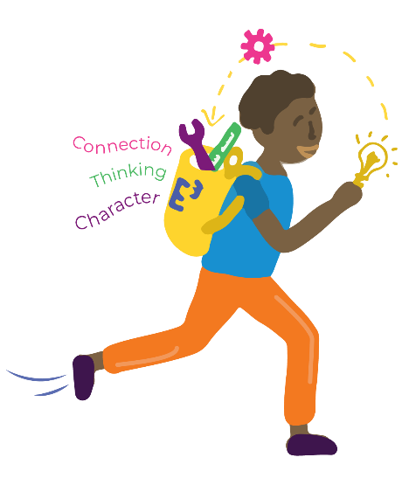
Integrated Projects and practicing 21st-Century Skills
The integrated project is
a way of teaching that encourages learners
to work together
to solve real world, relevant problems in doing so practice and grow
21st-Century Skills through integrated projects.

Slide 43
What does the evidence tell us about 21st-Century pedagogies?
Students demonstrate better problem-solving skills in Project-based Learning than in more traditional classes and are able to apply what they learn to real-life situations.
Finkelstein et al., 2010
On high-stakes tests, Project-based Learning students perform as well or better than traditionally taught students.
Parker et al., 2011
Students learning through Project-based Learning retain content longer and have a deeper understanding of what they are learning.
Penuel & Means, 2000; Stepien, Gallagher & Workman, 1993
In specific content areas, Project-based Learning has been shown to be more effective than traditional methods
for teaching math, economics, language, science, and other disciplines.
Beckett & Miller, 2006; Boaler, 2002; Finkelstein et al., 2010; Greier et al., 2008; Mergendoller, Maxwell, & Bellisimo, 2006
Playful learning can be implemented through a number of pedagogical practices such as Project Based Learning, where learners construct knowledge by exploring a real-world problem that is often driven by learners' interest in inquiry. For this reason, playful learning is necessary for ALL learners at any grade.
Hirsh-Pasek, Hadani, Binkoff, Golinkoff (2020),
Project-based Learning shows promise as a strategy for closing the achievement gap by engaging lower-achieving learners.
Boaler, 2002; Penuel & Means, 2000
Students demonstrate better problem-solving skills in Project-based Learning than in more traditional classes and are able to apply what they learn to real-life situations.
Finkelstein et al., 2010
Project-based Learning students also show improved critical thinking.
Beckett, G. & Miller, P. (Eds.) (2006). Tretten, R. & Zachariou, P. (1997). Horan, C., Lavaroni, C., & Beldon, P. (1996)
Through Project-based Learning experiences, students improve their ability to work collaboratively and resolve conflicts.
Tretten, R. & Zachariou, P. (1997) ChanLin, L. (2008).

Slide 44
Developing learners 21st-Century Skills
The creation of the learning environment which is a caring and safe.
The implementation of the learning practices we call S.P.E.C.I.A.L.
The application of the pedagogy such as the integrated project
Lead to young people practicing and growing their 21st-Century Skills.
+
+
=

Slide 45
The tip of the iceberg…
The integrated project - what you see on the surface
The science of learning, S.P.E.C.I.A.L. and everything that underpins the project and leads to learners developing their 21st-Century Skills and becoming prepared for success in a changing world.
Notes:
The purpose of this is also a learning experience.

Slide 46
Ask the audience
SHARE YOUR EXPERIENCES AND ASK ANY QUESTIONS

Slide 47
1, 2, 3… Yenza!
Accessing the GEC Trial’s Inclination Assessment on TeacherConnectchat
Thank
you.

