Slide 1

Playful project-based learning
THE DBE PLAN
Topic TWO
Notes:
Welcome

Slide 2
Programme
TIME | Min | ITEM
E.g. Time | TIME NEEDED | Item
08h00 – 08h20 | 20 min | Welcome and introductions
08h20 – 08h40 | 20 min | Ice-Breaker
08h40 – 09h05 | 25 min | Part One
09h05 – 09h20 | 15 min | Q & A

Slide 3

Ice-Breaker
Take 5 minutes to reflect on what you think your role is in today’s classroom.
You may be called upon to share your thoughts.

Slide 4

PART ONE
The DBE Plan
In this section we will cover the following
What is DBE-E3?
The E3 process
How will E3 bring a solution?
Assessment of the Projects
Written by teachers, for teachers
Theory of Change
E³’s compelling goal is that 100% of learners end up being Employable, become Entrepreneurs or further their Education after school.
The Monitoring and Evaluation
Notes:
Read out what the session will entail.

Slide 5
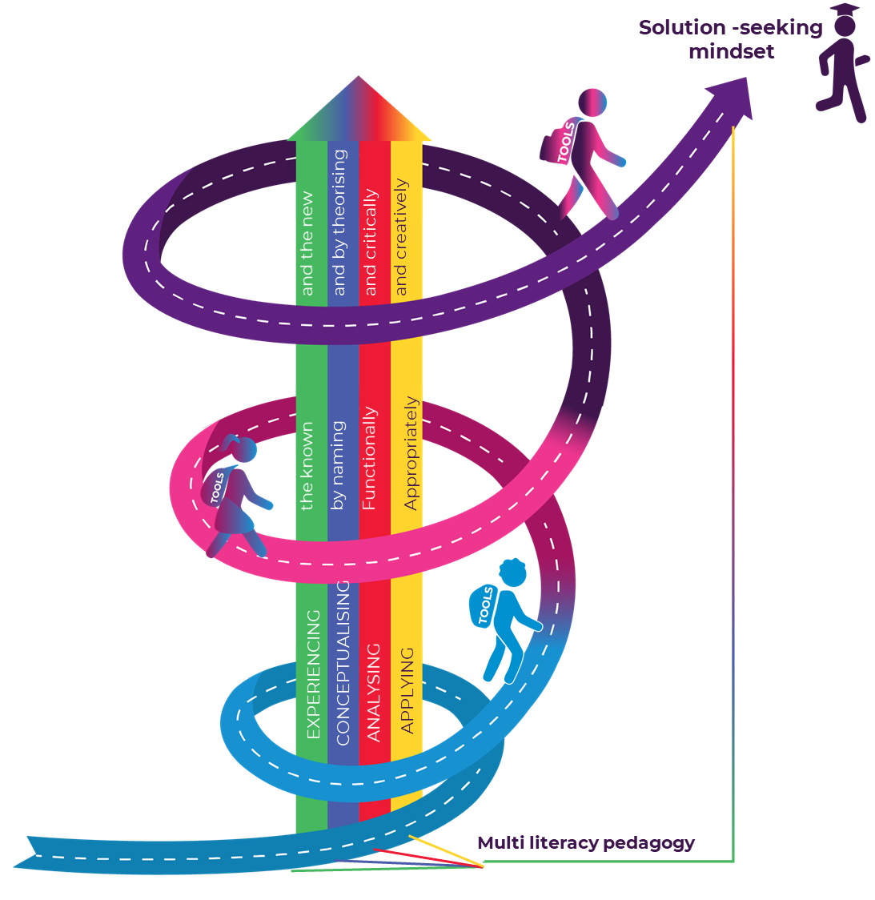

The DBE plan
The MTSF goals
2019
332 Schools
2021
3 600 Schools
73
2020
Design-based learning
2023
24 000 Schools
2022
13 600 Schools
Notes:
E³ is the result of a number of key country imperatives including the National Development Plan (NDP) which identifies education as being central to enhancing entrepreneurial capacity of the nation. The NDP states that courses should be designed, introduced and taught to promote and instill a culture of entrepreneurship in society (2012:469). On 02 April 2014, the Deputy President and key cabinet Ministers of the Human Resource Development Council South Africa (HRDC SA) approved the recommendations tabled by the “Enabling Entrepreneurship” Technical Task Team
(EETTT) and identified the Department of Basic Education (DBE) as the implementing agency for the “Entrepreneurship in Basic Education Grade R - 12”.
These decisions came about because of the increasing concern for the state of unemployment in the country. According to the Youth Enterprise Development Strategy 2013-2023 of the Department of Trade and Industry, South Africa has the third highest youth unemployment rate in the world (age 15 to 24) with 73% of youth being unemployed and 86% not having formal further or tertiary post-secondary education. A further two-thirds have never worked. South African youth are therefore not participating in the economy; they are not given the opportunity to acquire skills and work experience they need to assist in driving the economy forward; they are finding it more and more difficult to secure jobs due to inadequate job opportunities; and they are lacking in skills, work experience, job search abilities and financial resources to find employment.
In the light of this situation the EETTT proposed the embedding of Entrepreneurship Education into the National Formal Education of all learners from Grades R-12. Entrepreneurship Education involves action-led, practical learning that develops creativity, logical skills and problem-solving skills. Hence, in adding practical entrepreneurship and the development of higher order thinking skills to the curriculum, the employability of any learner going through the school system will be significantly enhanced and provide better opportunities for our learners. On 20 April 2015, the draft Sector Plan on E³ (EiS at that stage) was developed and presented for discussion at the Heads of Education Departments Committee (HEDCOM) Retreat. Following input from the provincial Heads of Education, the necessary amendments were made, and the draft Sector Plan was presented to the Council of Education Ministers (CEM) on 4 June 2015. CEM noted the draft Sector Plan and indicated that progress on its implementation should be reported on regularly.
As a result, the DBE held several meetings with the Community and Individual Development Association (CIDA) and the Maharishi Invincibility Institute (to be jointly referred to as CIDA) to discuss the implementation of the Sector Plan and the Memorandum of Agreement (MOA) during 2016.The MOA to implement the Sector plan was signed by DBE and CIDA in March 2017 and a steering committee comprising DBE officials from Branch C and CIDA was constituted. The DBE Sector Plan to 2030 aims to lay a sound foundation within the schooling system for future entrepreneurs with a strong focus on skills for a changing world. The Sector Plan on Entrepreneurship in Schools (EiS) was launched at the DBE Sector Lekgotla on 22 January 2018. It was noted that the Entrepreneurship in Schools (EiS) Programme will be located in the Curriculum Implementation and Quality Improvement GET Directorate.
In 2018 we started the pilot with 73 schools and, following the MTSF, a further 332 schools in 2019. We planned to implement active learning pedagogies, or active learning approach, in 600 schools last year but due to covid we were unable to do so. Those 600 schools have been added to the 3000 schools for the 2021 pilot and so this year we are implementing in 3600 schools. Next year we increase the number of schools reached to 13600 and an increase by a further 10 000 in 2023.

Slide 6
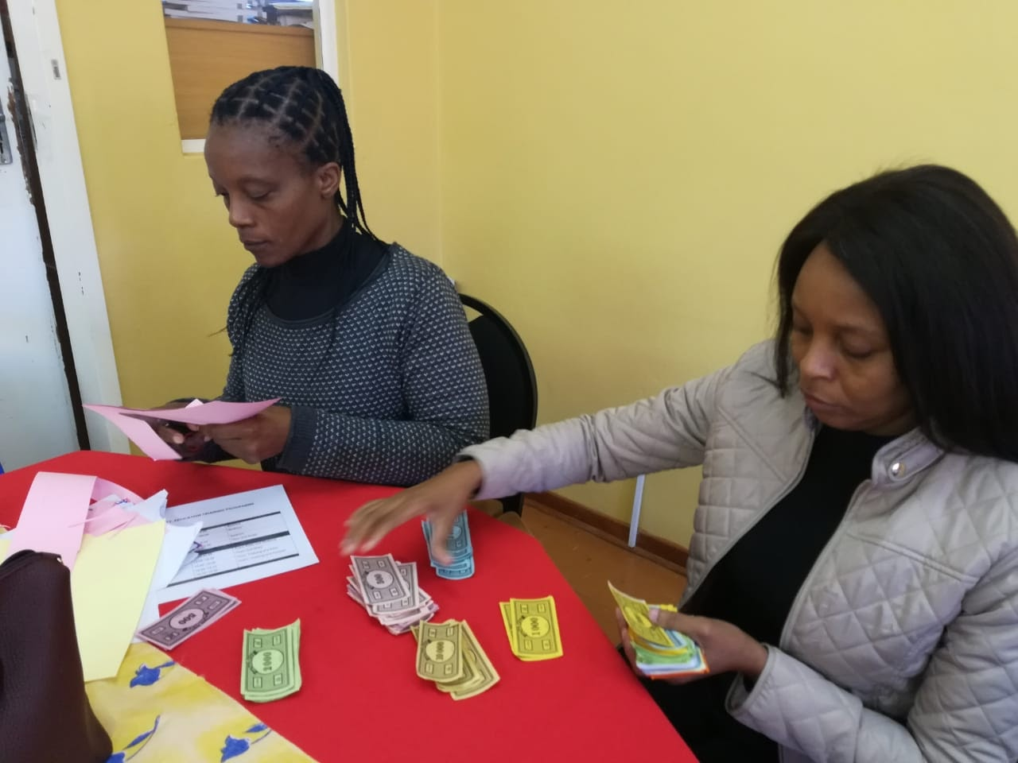
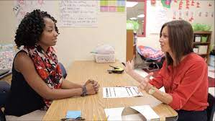
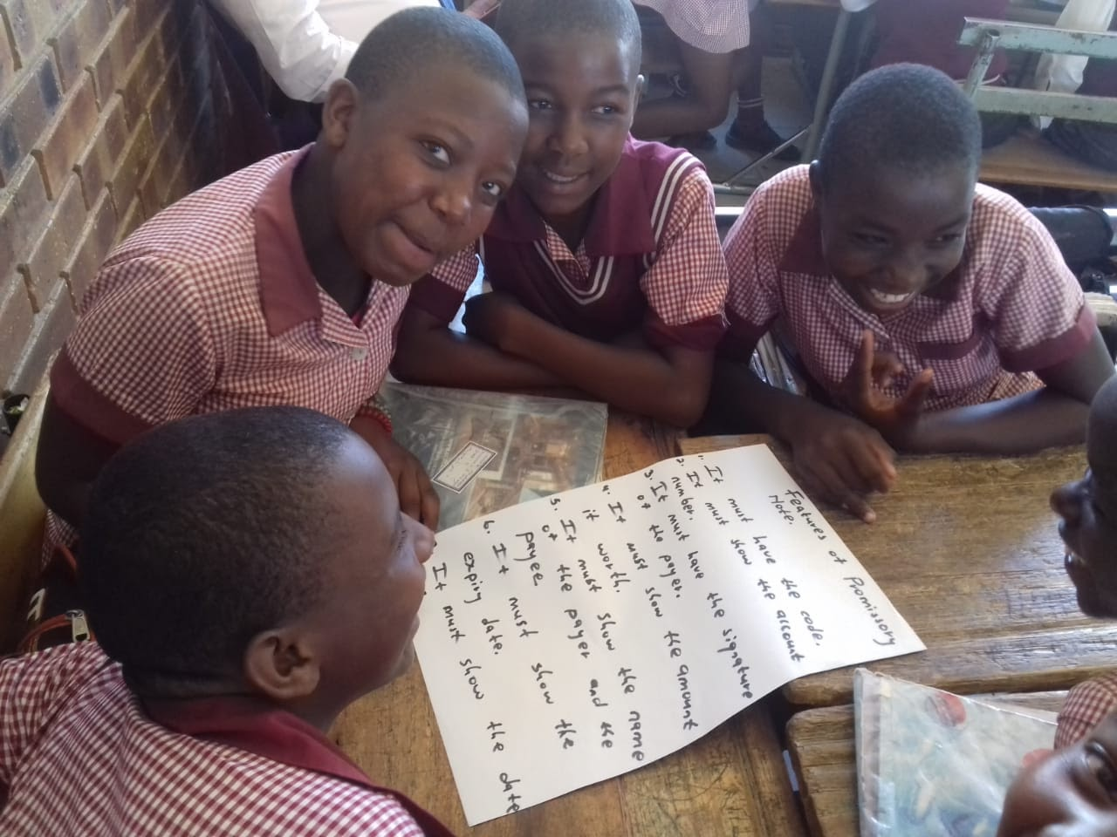
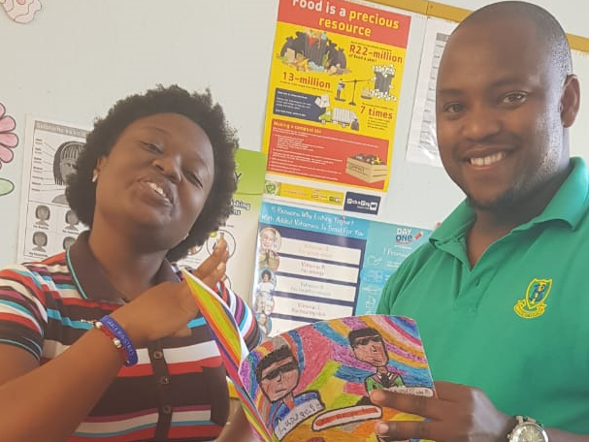
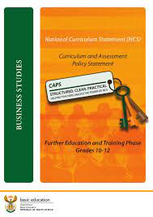
The DBE plan
In-school implementation
Coaching support for teaches – 2 in-school champions
Learner engagement
Effective teacher training in active learning pedagogies
Teachers happy
with their accomplishments
Nation building and development begins in schools
Notes:
Education is at the heart of nation building and development and it includes everything that happens within the school itself. The DBE plan includes support for teachers to apply active learning pedagogies to unlock the intention of the CAPS curriculum by promoting learner engagement and helps teachers accomplish their goals to prepare learners for the future endeavours.
The official Sector Plan guiding the work of EiS (E³ ) focuses on the following four Key Result Areas:
Collaboration with the Foundational Learning Task Team.
To improve foundational knowledge and skills in Mathematics, Science and Languages.
Introduction of Mandatory Entrepreneurship Education.
To implement an entrepreneurial curriculum for learners in all grades.
• Short term (1 – 2 years): Increase exposure to entrepreneurship (extra-co-curricular)• Long term (3 – 5 years): Infuse 21st century thinking concepts throughout curriculum. New teacher’s education for new and existing teachers.
To ensure that Entrepreneurship becomes part of initial teacher education so that the new graduate teachers are able to:
• Integrate entrepreneurial and financial literacy concepts in their respective subjects;
• Acquire a better understanding of entrepreneurship concepts; and
• Improve their soft skills;
• To encourage teachers to be agents of change / become entrepreneurial teachers;
• To develop teachers as facilitators of learning in order to guide the learning process instead of communicating knowledge;
• To equip teachers (new and existing) with the “HOW” of Participatory Action Learning and Research and Experiential teaching methods (games, interactive activities, reflective learning);
• To expose teachers to the real business environment (practical experience);
• To up-skill teachers with regard to managing Entrepreneurs’ Days; and
• To use IT hubs (countrywide) for training and resources for existing teachers.
Actively encourage businesses to engage with local educational institutions
• To partner businesses with schools to make entrepreneurship real for both teachers and learners;
• To participate in work-shadowing activities designed to assist teachers to gain a better understanding of industry practices; and
• To provide funding to support entrepreneurial projects

Slide 7








The DBE plan
PPBL Teacher Development 2021
Traditional workshop / online learning
Coaching support
Staff development
Observation
School development process
Professional learning communities
SMT Action Research
Cohort 1 – E³ team
Cohort 2- DBE Master Trainers
Cohort 3- Partners and online platforms
Cohort 1 – E³ team
Cohort 2- DBE Master Trainers
Cohort 3- Partners and online platforms
Cohort 1 – E³ team provides bespoke support
Cohort 1 – E³ team
Cohort 2- DBE Master Trainers
Cohort 3- On-line guidance
Cohort 1 – E³ team
Provides training for teachers and SMTs for co-involvement
Cohort 1 – E³ team
Cohort 2- DBE Master Trainers
Cohort 3- On-line guidance
Cohort 1 – E³ team
Cohort 2- DBE Master Trainers
You are here
White Belt online course available to everyone
Notes:
Cohort 2 follows a business-as-usual model with E³ supporting the DBE and district teams to train and support teachers.

Slide 8
What is DBE-E3?
01
Entrepreneurship
Search and Discovery generation
02
Employability
People who are flexible and take initiative
03
Education
Unlock the love of learning and curiosity
Notes:
The E³ approach
Because of the challenges that 4IR is bringing, the crises emerging around climate change and pandemics, and the alarming unemployment rates (particularly amongst the youth), the Department of Basic Education (DBE) wants to ensure that school leavers have the skills they need to find jobs, start a business or continue to a tertiary career.
E³ ('Entrepreneurship, Employability, and Education') is the national Department of Basic Education programme to ensure that:
• 100% of school learners complete school (and do not drop out); and
• 100% of these school leavers are equipped with the skills to:
E - become entrepreneurs in the future, i.e., start own enterprises;
E - become employable, i.e., get a job; or
E - become educated, i.e., stay at school or join a tertiary TVET, Technikon or University and successfully study further as a lifelong learner.
Click:
Entrepreneurship
E³ champions learners who are people of the search and discovery generation, who believe ‘if it’s going to be, it’s up to me’. They have a search and discovery, opportunity-seeking mindset that drives their purpose in helping others. They are not linked to a particular age group – rather they display a particular mindset: a common logic that drives their abilities and actions. They exist within established organisations and/or they create new ones. In order for an education system (starting at school) to develop these learners, every element of the E3 approach must be unlocked.
This includes the E³ mindset (self-efficacy, a growth mindset, resilience, an internal locus of control, and intrinsic motivation) and the 21st century skills (foundational literacies, competencies and character qualities, rooted in lifelong learning).
Click:
Employability
In addition to specific skills a job might require, employers are often looking for what is known as 'employability skills' and 'soft skills'. These would include communication, teamwork, problem-solving skills, initiative and enterprise, planning and organising, self-management, and a commitment to life-long learning. Generic employability skills are important because the labour market is intensely competitive, and employers are looking for people who are flexible, take the initiative, and have the ability to undertake a variety of tasks in different environments. Employees with a capacity for change as the environment changes will be in high demand. Collaboration between different stakeholders should be explored to create opportunities for a transversal solution to youth unemployment. This should start in the classroom and extend to building supportive ecosystems around schools and communities.
Click:
Education
As teachers, we are strong models in a learner's world. Good teachers model a love for learning, and continuous learning. This is excellent because one of the E³ goals is for teachers to unlock this love of learning and curiosity about the world within their learners.
Thus:
• Teachers should be encouraged to take charge of their own professional development.
• Teachers should truly embrace the concept of lifelong learning in a fast-paced knowledge space.
• The “lone wolves”, who in the past, would often embark on quality educational projects alone at their own school will now be acknowledged by “banking” SACE CPTD points for all the hard work they have accomplished.
• Not only will learners' learning improve, but if the process is honest and productive, schooling in South Africa will show positive results.
Of course, our learners should also be influenced to continue learning. In a rapidly changing world, lifelong learning will ensure success. So not only will you benefit, but your school and most importantly, your learners will also benefit, as will the reputation of South African education, which needs to adapt to a changing world.

Slide 9
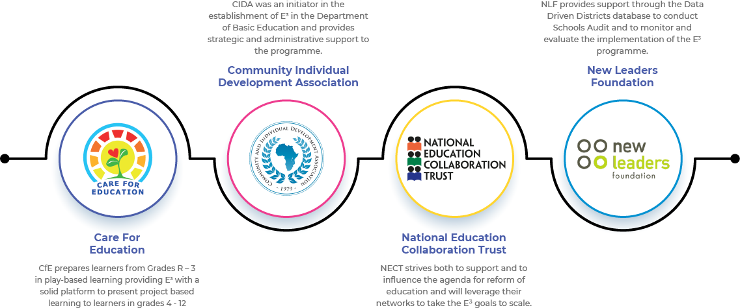
The E3 process
The DBE plan
Notes:
The E³ process
Who will manage the process?
The E³ programme was commissioned and is owned by the DBE and is delivered in partnership with C.I.D.A. as the programme management and implementation partner and New Leaders Foundation (NLF), who are now known as DIG, as the monitoring and evaluation (M&E) partner.
In addition, since E³ was initially being implemented only in the Intermediate, Senior and FET Phases (Grades 4 – 12), the programme has also partnered with Care for Education, who are experts in the development of thinking skills and competencies needed for a changing world within the Foundation Phase (Grade R to 3 learners).
This partnership, in which Care for Education will provide excellent training material and specialist advice, seeks to ensure the continuous engagement of South African learners in active learning approaches, which include play-based and Project-based Learning, throughout their schooling years.
Governance structure
The programme also has a robust governance structure to enable strategic focus and accountability. The programme has established two bodies, the Steering Committee and the Advisory Council, to oversee implementation, coordinate different work streams, and track progress. These two bodies comprise representatives from the DBE, C.I.D.A., DIG and Care for Education.

Slide 10
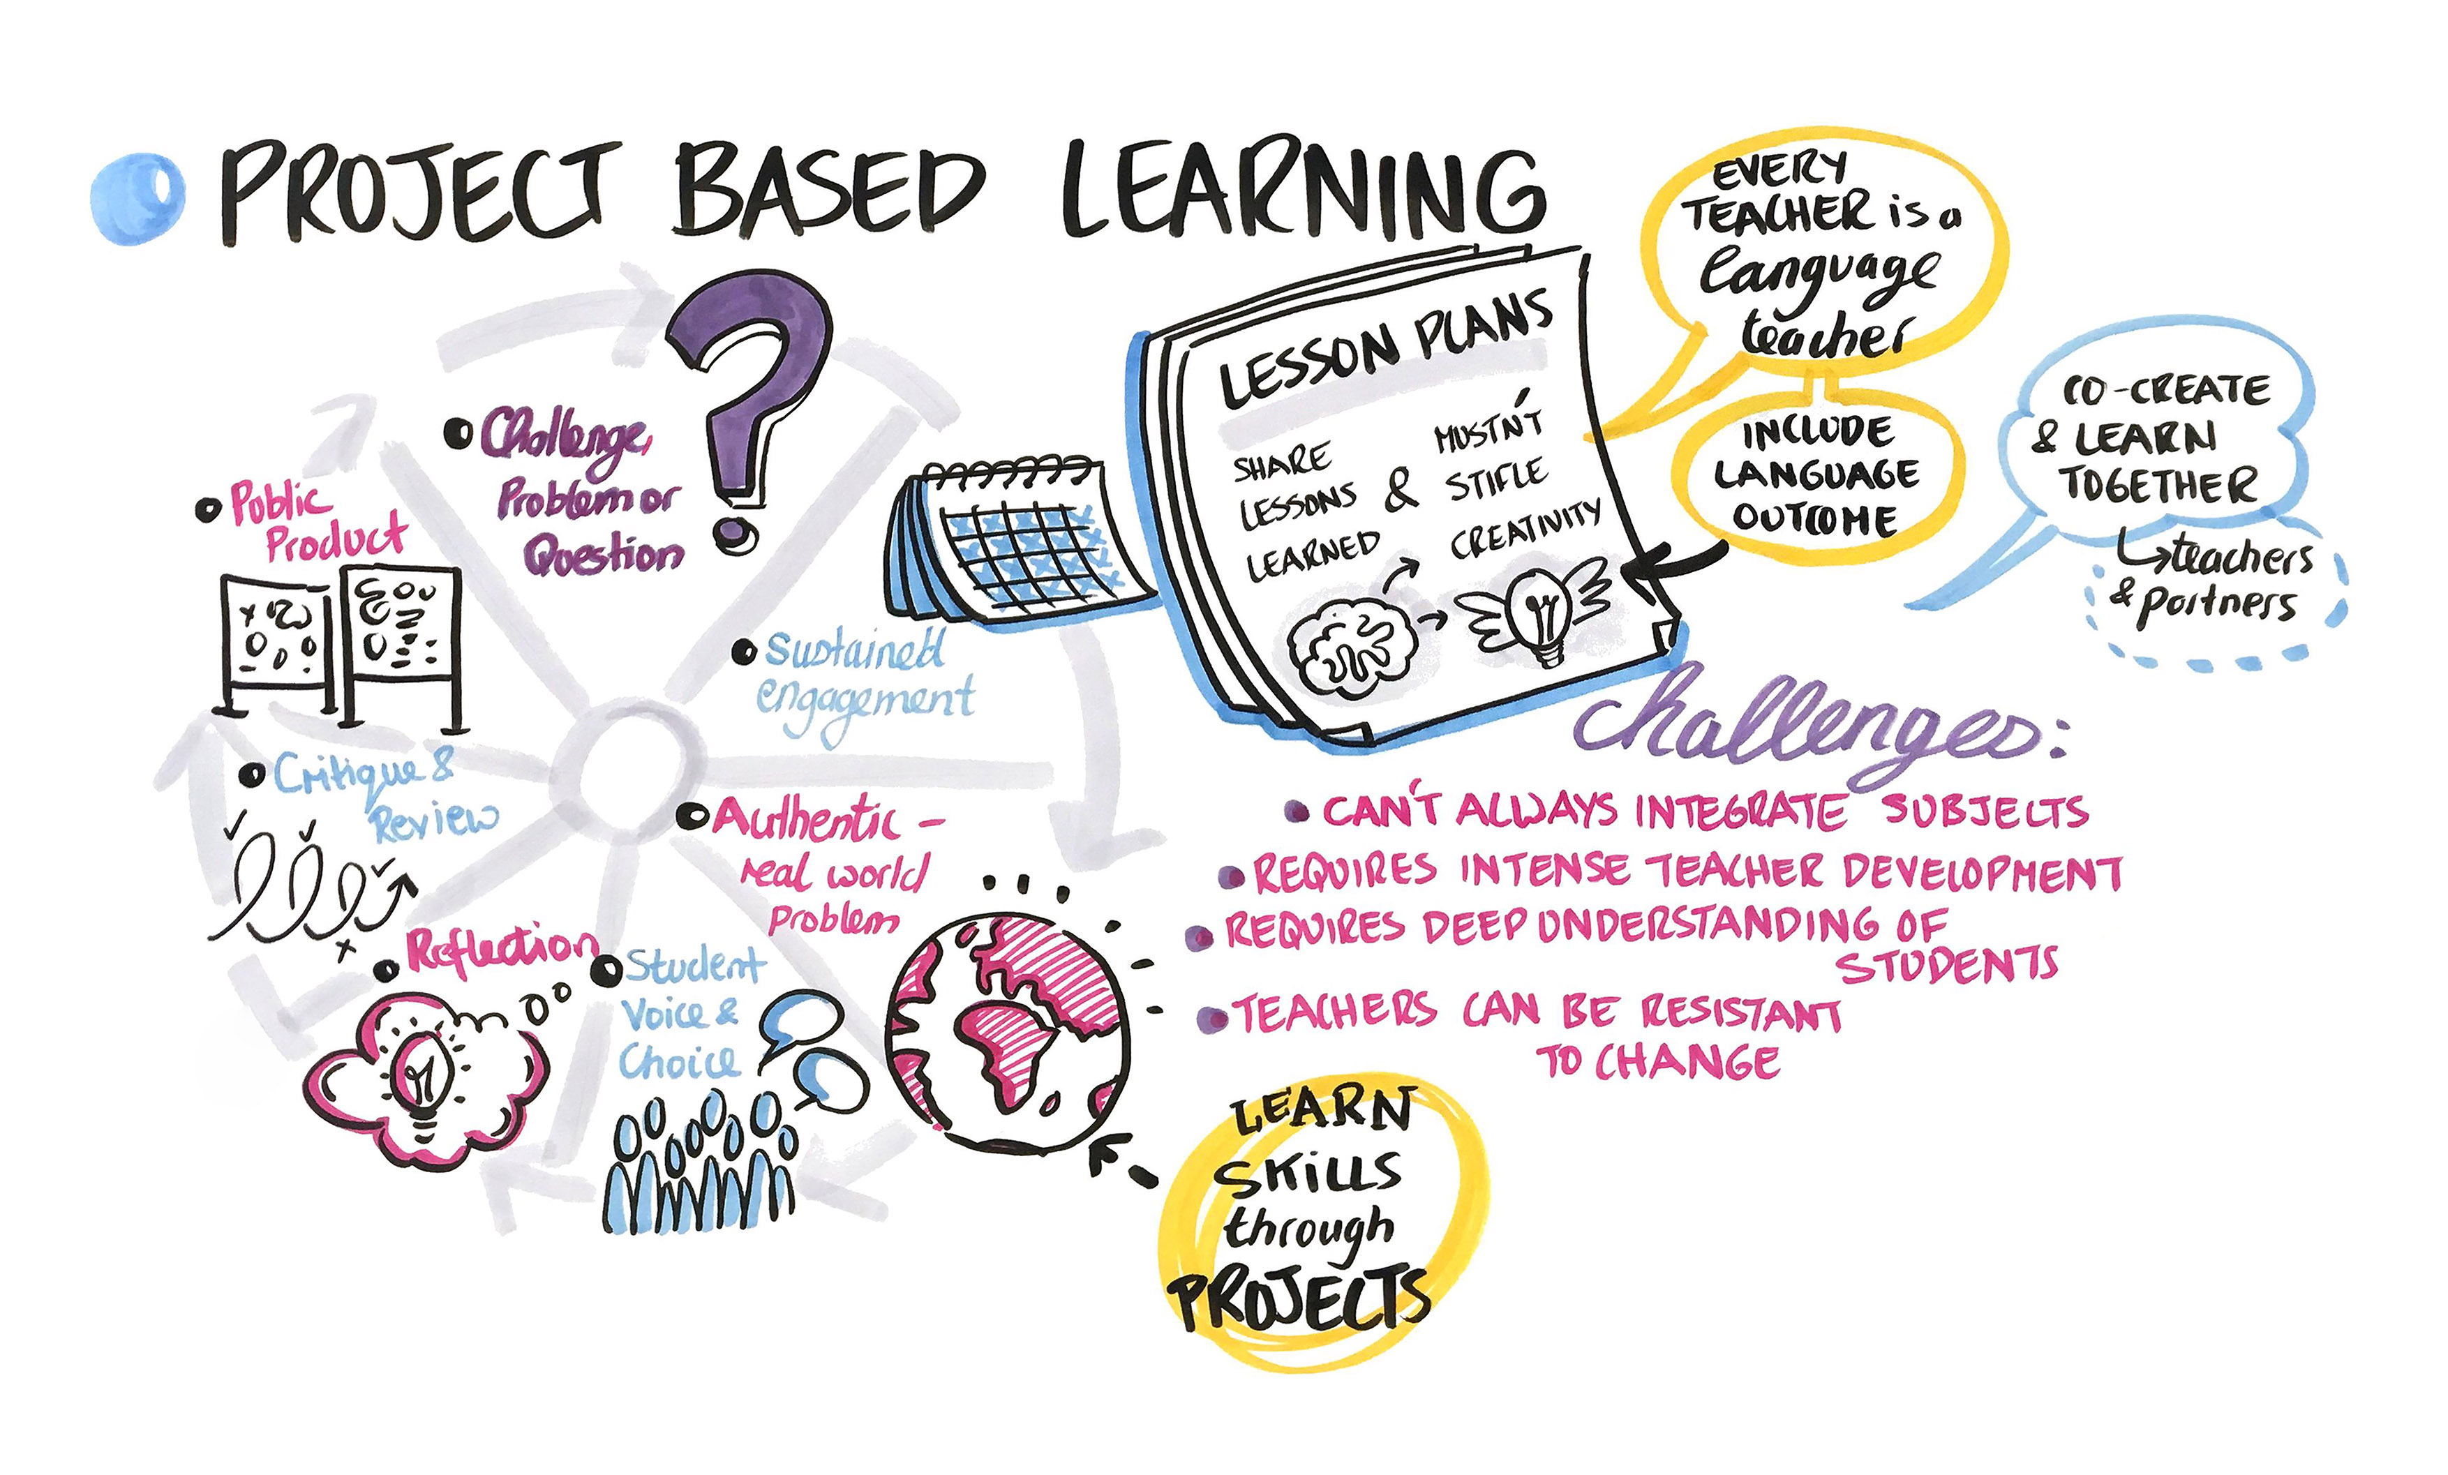
How will E3 bring a solution?
The DBE plan
Notes:
E³ is a programme which will, by 2030, bring about a change in the South African national school education system. It will ultimately impact all learners in the SA school system (12.9 million learners).
The approach:
Playful Project-based Learning Project-based Learning (PBL) is the vehicle that will be used to build the skills needed to achieve employability, entrepreneurial skills and the opportunity to enter tertiary education. Authentic, real-life scenarios and activity-based learning, which is experiential and practical, and thus more fun and inspiring to learners, will be promoted. Tools and ways of thinking to better solve problems, both alone and with others, will be explored. In this way, learners will develop the relevant skills and competencies needed in a modern economy. There will be an intentional move away from wholly traditional teaching (if chalk-and-talk is fit for purpose, it remains valid) towards a more learner-centered approach that takes a play-based approach. Research has proven that play is an essential vehicle for learning. Play, by nature, includes many different experiences from free play to more structured experiences. Play is also fluid, as children (and adults) navigate multiple domains of learning at the same time. Stimulating all aspects of a child's development, it is multi-sensory and tailored to the interests and needs of the young person.
For example, through role play, children develop their emotional, social, thinking and language skills (Lillemyr, 2009 p.9). The Lego Foundation (2017) refer to five skills for holistic development that highlight the importance of a child's Emotional, Cognitive, Physical, Social and Creative Skills. The Lego Foundation explains that through play, children must experience agency (2017, p.11), be supported rather than directed, exercise choice and voice, and pursue their interests. For these reasons, Project-based Learning is an excellent vehicle or process, as it provides the framework for creating the environment where children can explore their interests through participating in a relevant real-life project that seeks solutions for other people and unlocks their own agency.
CAPS alignment In each grade, an anchor subject is selected and an activity-driven project, which covers In each grade, an anchor subject is selected and an activity-driven project which covers most of the content, especially in the trimmed ATPs all the content required by the CAPS in a specific term, will be written in such a way that teachers will be provided with a step-by-step recipe for unpacking the project. Because Term 3 is generally the term in which the CAPS requires projects and case studies to be undertaken for SBA, in the first few years of the pilot, Term 3 will be the term in which PPBL will be implemented, driven or anchored by the following subjects: Grades 4 –6 (Life Skills) Grades 7 –9 (Economic and Management Sciences) Grades 10 – 11 (Life Orientation

Slide 11
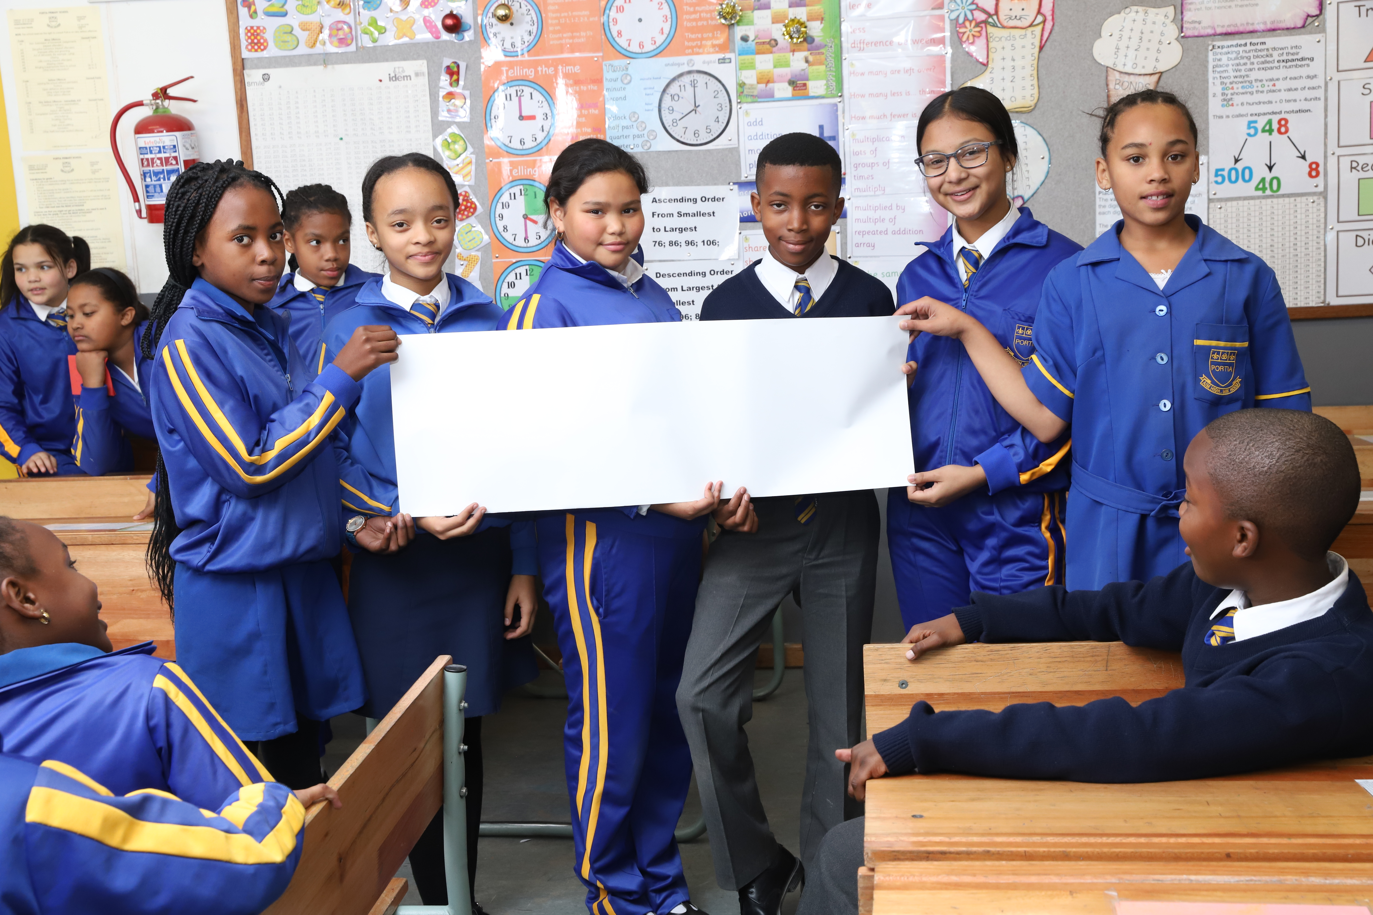
Assessment of the Projects
The DBE plan
2021 3rd Term Projects
Notes:
Assessment of the Projects
The project in Term 3 is part of formal school-based assessment and “counts for marks”. The results will be recorded on the national assessment database, SA SAMS. Items on the assessment rubric which are being updated to align with the adjusted ATPs and will be unpacked with teachers during training.
The Formal Assessment Task for Term 3 (the term of the pilot) is a project, as opposed to other activities, and teachers need to submit a mark or a grade using the assessment rubric as a guideline. The results are monitored on SA SAMS.
In 2021, the adjusted ATPs will be used to guide the content of the projects. Although there will be a core or anchor subject housing each project as stated above, the project will encourage integration with other subjects, especially the Language of Learning and Teaching (LOLT). With time, teachers will see the value of collaboration in assessment as well.

Slide 12
Written by teachers, for teachers
2021 Schools – the cohorts and case studies
1
2
3
4
GEC
Testing global best practice
Testing and improving “business as usual” earlier model
Testing & improving scalability using online platforms & partners
Collecting case studies from “opt in” schools
Trial of PPBL as part of the DBE’s GEC
108
498
3000
+50
45
Supported by E³
Coaching team
Supported by District teams
Supported through online platforms
Self- and community-selected schools
Opportunity for innovative data gathering
May to October 2021
Trial a 1.5-term project for deep research on PPBL efficacy
Notes:
Written by teachers, for teachers
To ensure that teachers take ownership of the projects and that the projects are relevant to South African school classrooms, the original projects were written by teachers, and scrutinised by Playful Project-based Learning experts who acted as co-writers and peer counsellors. These projects have been updated and aligned with the trimmed curriculum. Due to Covid-19 restrictions, a team of educators was involved with the writing and it is envisaged that during training, Master Trainers will work with teachers to customise the projects for their local contexts. Grade 4-11 projects that were written in 2018 and 2019 have been updated and recalibrated based on lived experience of teachers during implementation. Small-scale trials (E³ ”laboratories”) will be carried out on different projects in subjects other than those selected for the broad implementation plan. Teachers involved in these projects will conduct small Action Research projects to test the approach and to start building up a local repository of original projects. They will report on the learner engagement, the results, the impact, and advise on to how they may be improved. See Cohorts 1-4 above.

Slide 13
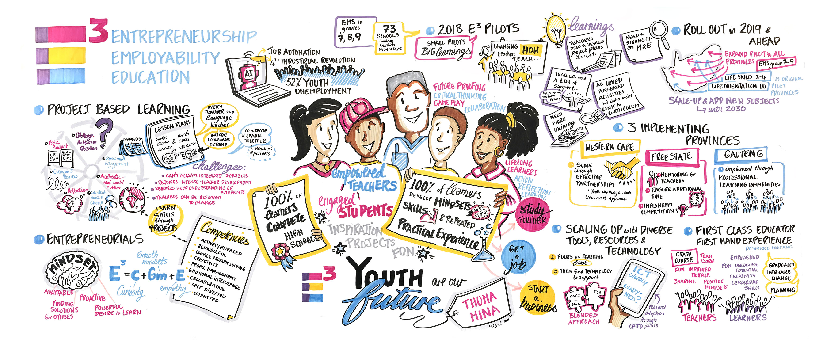
The Monitoring and Evaluation
Notes:
The Monitoring and Evaluation
• The pilot
A three-year pilot (2019 – 2021) was launched at the beginning of 2019, which rolled out E³’s Project-based Learning approach in Gr 4-6 Life Skills, Gr 7-9 Economic and Management Sciences and Gr 10 Life Orientation across 350+ schools.
In 2020, the roll-out of Grades 4-10 will extend to 600 schools.
• Role of M&E The role of the M&E is to support the programme by clearly defining the change that is intended, testing theories and assumptions on how change would be achieved in the South African context, and in gathering evidence against this intended change along casual pathways, from implementation to results, for the purposes of learning and improving implementation.
• M&E evidence
The pilot and ongoing M&E processes will therefore test aspects of, and provide adequate evidence on, the following:
the implementation of the programme (number of training sessions and attendance; other engagement indicators);
- the effectiveness of training and skills transfer (assessment and observations);
- the quality of teaching (teacher practices reflecting changes in knowledge, skills, attitudes and values) and learning taking place (learner outcomes from SA-SAMS; teacher behavioural indicators); and
- the changes in learners’ knowledge, skills, attitudes and values (survey and results). From a longer-term perspective, it will test the impact of E3 in schools on schooling and post-school outcomes.
Lessons learned from the 2019 baseline and plans made to address challenges
The lessons learned from the baseline study conducted in 2019 are briefly outlined below, and it is these recommendations that have informed the updating of this manual:
Lesson 1. Current understanding of E³ is limited.
Lesson 2. Knowledge of PPBL is limited.
Lesson 3. Training did not adequately prepare them for classroom implementation.
Lesson 4. Providing adequate support is needed to manage the rapid E³ implementation and roll-out.
Lesson 5. Failure to clearly and timeously communicate E³ plans, roles and requirements hampers effective implementation.
E3 plan of action to respond to the M&E:
Leading to the July to September roll-out, the following support interventions were planned and are being carried out to address identified challenges:
Dec 2019: Tested training manual with Free State DTDCs Jan 2020: A DCES meeting was held to gather first-hand feedback. Feedback from the provinces was also included in the update as the manual and projects were checked for language and other changes.
Jan/Feb 2020: Writer’s workshop (teachers and officials) (28) As a result of COVID-19, the roll-out was stopped and the Implementation team decided to focus on learning as we were not permitted to access schools and therefore could not reach learners or teachers.
An online course was created and thus far, 130 Master Trainers have been trained to assist in the training of teachers in 2021.
This training will start in May 2021 and end in July. Since the 2019 Baseline Report, a new Synthesis Report (2021) from the monitoring and evaluation team has shown that teachers had a remarkably challenging 2020, struggled with the new normal (especially the online training) and are needing even more support.

Slide 14
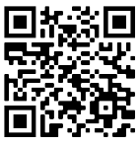
Get connected
Find out what you need for this journey by adding TeacherConnect as a contact on WhatsApp with the number 060 060 33 33 and send the world BELT to start with training on our zero-rated platform, or use the TeacherConnect QR code below:
The Teachers’ Lounge
https://www.teacherconnect.co.za/share/49Q5oaJa85GQmb9C?utm_source=manual
Notes:
Before we end, please feel free to link up with the E³ journey on TeacherConnect and in the Teachers’ Lounge.

Slide 15
www.ecubed-dbe.org
Thank you – see you soon

